Slide 1
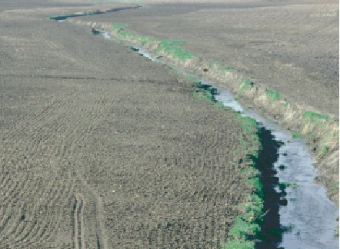
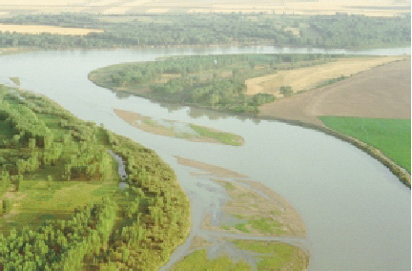
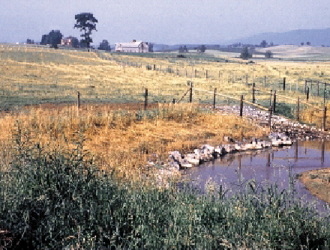
Channel Design
River Engineering
Stream Restoration
Canals

Slide 2
References
Chapter 12 Stable Channel Design Functions in the HEC-RAS Hydraulic Reference
FISRWG (10/1998). Stream Corridor Restoration: Principles, Processes, and Practices. By the Federal Interagency Stream Restoration Working Group (FISRWG)
Chapter 4 in Water Resources Engineering by David Chin (2000)

Slide 3
Outline
Sediment transport
Effects
Suspended and Bed load
Stable unlined channel design
Tractive Force method
Bed forms
Channel forms
River Training
Stream Restoration Principles

Slide 4
Problems of Sediment Transport
Impingement of Sediment Particles
damage to bridge abutments by boulders
huge boulders (up to several tons) can be set in motion by torrential flood flows in mountain streams
sand-sized particles damage turbines and pumps
Sediment in Suspension
fish don’t like muddy water
municipal water treatment costs are related to amount of sediment in the water

Slide 5
Problems of Sediment Deposition
Flood Plain Deposits
may bury crops
deposition of infertile material (like sand) may reduce fertility
Urban areas may receive deposition on streets, railroads, and in buildings
irrigation ditches
reduce carrying capacity
require extensive maintenance
drainage ditches
raise the water table
fine sediments are usually fertile - increase vegetation growth - increase Manning n

Slide 6
Problems of Sediment Deposition
channels, waterways, and harbors
requires extensive dredging to maintain navigation
decrease carrying capacity and thus increase flooding
lakes and reservoirs
in lakes with no outlets all of the incoming sediment is deposited
converts beaches to mud flats
fine sediment can encourage prolific plan growth
storage capacity is lost
by 1973 10% of reservoirs built prior to 1935 in the Great Plain states and the Southeast had lost all usable storage!

Slide 7
Sediment Load
Mass of sediment carried per unit time by a channel
Sediment load is carried by two mechanisms
Bed load: grains roll along the bed with occasional jumps
primarily course material
Suspended load: material maintained in suspension by the _________ of flowing water
primarily fine material
turbulence

Slide 8
Suspended Load
Sediment suspended by fluid turbulence
Concentration can be substantial in cases of high flows and fine sediment (up to 60% by weight!)
Vertical distribution
higher concentration near bottom
coarse fractions - concentration decreases rapidly above bed
fine fractions - concentration may be nearly uniform
no theory for concentration at the interface with the bed
given sediment concentration at one elevation above the bed it is possible to derive sediment concentration as a function of depth (compare local fall velocity with local turbulent transport)

Slide 9
Suspended Sediment Upward Transport
z
upward transport is due to diffusion flux (Fick’s first law)
The diffusion coefficient is a function of depth!
D
D = Velocity * Distance
k = von Kármán’s universal constant
k = 0.4 for clear fluids
D_{t}

Slide 10
Suspended Sediment Concentration Profile
at steady state we have:
upward transport = downward transport
where
boundary condition: c = c_{a} @ z = a
by convention: a = 0.05h
sedimentation velocity
Result after integration

Slide 11
Suspended Sediment Equilibrium Profile
Why?
z
1
0.8
0.6
D
Depth/D
0.4
0.2
v
D_{t}
a
0
0
5
10
15
20
sediment concentration

Slide 12
Bed Load
Dependent on
sediment size distribution
bed shape (ripples, dunes, etc.)
sediment density
shear stress at the bed
Bed Load Equations
many researchers have proposed equations
each equation only applies to the data that was used to obtain the equation!

Slide 13
Total Sediment Carrying Capacity
Power law relations between sediment flux (J_{s}) and specific discharge (q) fit the data when the exponent (n) is between 2 and 3
Consequences:
as q decreases J_{s} decreases
abstraction of flow from a river
for irrigation, water supply or flood relief
sediment carrying capacity decreases
river channel tends to clog with sediment to reach new equilibrium
greatest transport of sediment occurs during floods
rivers below reservoirs tend to erode

Slide 14
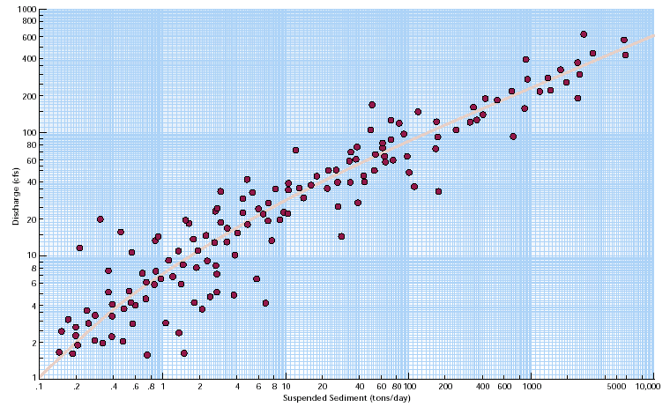
Sediment Rating Curve:
10Q yields 100J_{s}

Slide 15
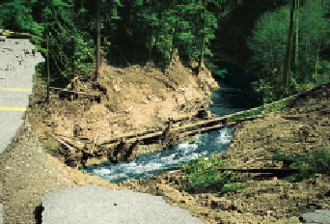
Causes of Stream Erosion
What can increase the rate of erosion?
Increased stream flow
Increased runoff
Decreased flood plain storage
Decrease in sediment from upstream

Slide 16
Channel Design: Identify the Parameters
Channel Geometry
Channel Slope
Cross section
Roughness
Meander
Soil
Grain size
Cohesive/uncohesive
Lining type
Lined
Unlined
Grass
Design Flow
Bank full
Or based on a recurrence interval

Slide 17
Stable Unlined Channel Design
Threshold of movement
Will determine minimum size of sediment that will be at rest
Can be used as basis for stable bed design
Based on Shield’s diagram
Modified to include the effect of side slope

Slide 18
Basic Mechanism of Bed Load Sediment Transport
drag force exerted by fluid flow on individual grains
retarding force exerted by the bed on grains at the interface
particle moves when resultant passes through (or above) point of support
V
h
force of drag will vary with time
F_{d}
F_{g}
θ
Grains: usually we mean incoherent sands, gravels, and silt, but also sometimes we include cohesive soils (clays) that form larger particles (aggregates)
point of support

Slide 19
Threshold of Movement
Force on particle due to gravity
Force on particle due to shear stress
We expect movement when
Force balance
θ
dimensionless parameter

Slide 20
Shields Diagram (1936)
inertial
Re* _____________ =
Shear Reynolds
at the bed!
viscous
d = particle diameter
1
Suspension
Saltation
0.1
0.056
No movement
Threshold of movement
0.01
1
10
100
1000
Laminar flow of bed
Turbulent flow of bed

Slide 21
Shear Velocity
Bottom shear
u* = shear velocity =
From force balance
turbulent
Shear velocity is related to _________ velocity

Slide 22
Magnitude of Shear Velocity in a River
Example: moderately sloped river
Susquehanna at Binghamton
S = 10⁻⁴
d =R_{h}= 1 m
Manning Eq. (SI) units
assume n of 0.03
Velocity fluctuations in rivers
are typically ­ _____
0.1V

Slide 23
Application of Shield’s Diagram
Find minimum particle size that will be at rest
Often bed is turbulent
quartz sediment
Example (Susquehanna River at Binghamton)
1 m deep, S = 10⁻⁴
Therefore 1.1 mm diameter sand will be at rest.
Result is “armoring” of river bed with large gravel as smaller sediment is flushed out.

Slide 24
Application to Channel Stability
Assumed uniform shear stress distribution
φ
river
φ = max angle of repose ­ 35°
τ_{max}
to prevent erosion of bottom

Slide 25
Channel Side Slope Stability
Takes into account the shear stress, force of gravity and coefficient of friction
Meandering (sinuous) canals scour more easily than straight canals (see Table 4.15 in Chin)
Critical shear stress on the side slope
Critical shear stress on the bed
Tractive force ratio
Side slope angle
Angle of repose
Ch 12 in HEC-RAS Hydraulic Reference

Slide 26
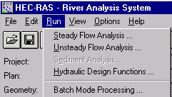
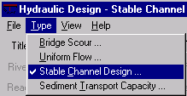
HEC-RAS Hydraulic Design: Stable Channel Design
Copeland*
Regime*
Tractive Force
Doesn’t account for input sediment
Utilizes critical shear stress to determine when bed motion begins
Particle size (d)
Depth (D)
Bottom Width (B)
Slope (S)
Uses shear stress and Manning equations
Given any two can solve for the other two
*Require input sediment discharge

Slide 27
Implications
How could you reduce erosion in a stream?
Are we managing causes or treating symptoms?
Decrease slope
Decrease depth (increase width or decrease flow)
Increase particle size

Slide 28
Vertical Stabilizing Techniques
Aggradation
Degradation
stabilizing eroding channels upstream
controlling erosion on the watershed
installing sediment traps, ponds, or debris basins
narrowing the channel, although a narrower channel might require more bank stabilization
flow modification
grade control measures
other approaches that dissipate the energy
meanders
boulders

Slide 29
Bank Stabilizing Techniques
Indirect methods
extend into the stream channel and redirect the flow so that hydraulic forces at the channel boundary are reduced to a nonerosive level
dikes (permeable and impermeable)
flow deflectors such as bendway weirs, stream “barbs,” and Iowa vanes
Surface armor
Armor is a protective material in direct contact with the streambank
Stone and other self-adjusting armor (sacks, blocks, rubble, etc.)
Rigid armor (concrete, soil cement, grouted riprap, etc.)
Flexible mattress (gabions, concrete blocks, etc.)
Vegetative
can function as either armor or indirect protection and in some applications can function as both simultaneously.

Slide 30
Bed Formation
Variety of bed forms are possible
may be 3 dimensional
may vary greatly across a river or in the direction of flow
Bed forms depend on Froude number and affect ____________
Bed forms result from scour and deposition
deposition occurs over the crests and scour occurs in the trough
Bed forms are the consequence of instability
a small disturbance on an initially flat bed can result in formation of crests and troughs
roughness

Slide 31
Bed Forms
low velocity, fine sediment
sand wave moves down stream
wavelength less than 15 cm
Ripples, Fr << 1
intermediate between ripples and dunes
weak boil
Dunes with superposed ripples, Fr < 1
larger and more rounded than ripples
boil
Dunes, Fr < 1

Slide 32
Bed Forms (2)
Dunes are eroded at Froude number close to 1
Note reduction in friction factor or Manning n!
Flat bed, Fr = 1
Standing waves in phase with water waves
Standing waves, Fr > 1
Sand waves move upstream
wavelength is
incipient breaking and moving upstream
Antidunes, Fr >> 1

Slide 33
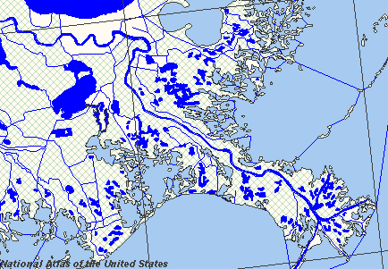
River Channels
Alluvial soils
river can form its own bed
river will meander in time and space
steep slopes
braided channel
intermediate slopes
riffle pool formation
mild slopes
meandering channel

Slide 34
Meandering Channel
L
r_{c}
B
scour
flow centerline
surprisingly small variation!

Slide 35
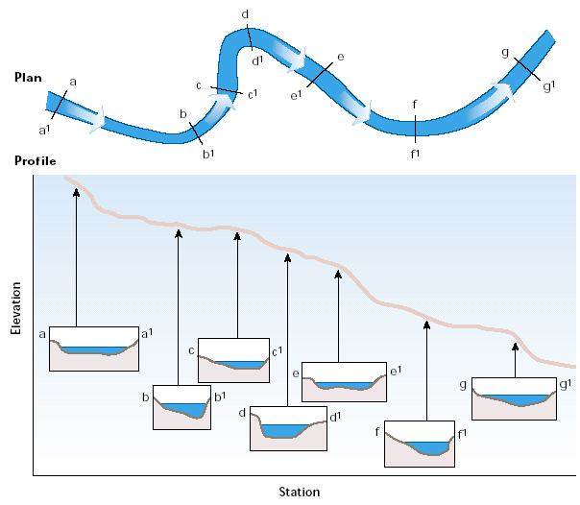
Bed Forms in Meandering Channels
Channel is deepest on the outside of the curves

Slide 36
River Training
Prevent shifting of river bed!
navigation
want the docks to be on the river!
flood control
want river to be between the levees!
bridges
want bridges to cross the river!
Canalize - straighten out meanders
cutoff meander - increases slope
increases erosion
deposition further downstream

Slide 37
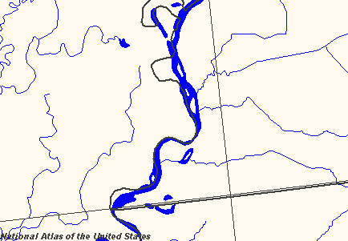
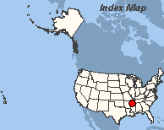
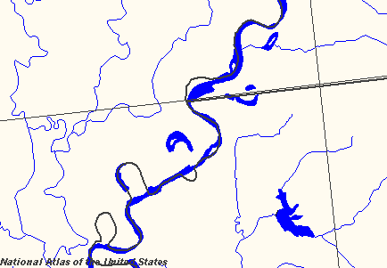
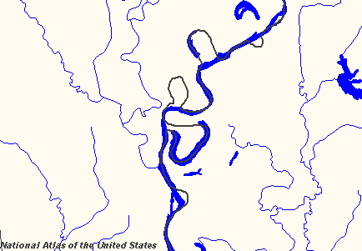
Changes to Mississippi River
Braided channel
Arkansas
Mississippi
Former Oxbow
Consequences?

Slide 38
River Training
Current practice - “Stabilize” in natural form
bank protection
rip-rap (armoring)
Groins (indirect)

Slide 39
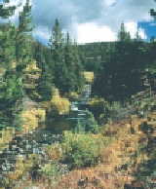
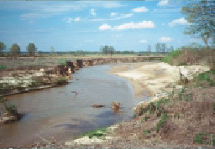
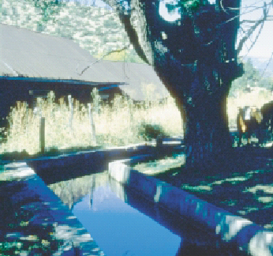
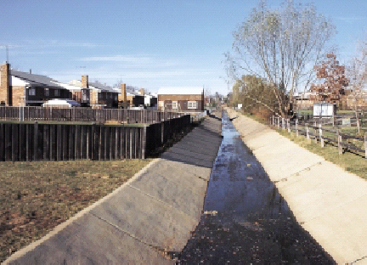
Stream Corridor Condition Continuum
At one end of this continuum, conditions may be categorized as being natural, pristine, or unimpaired by human activities
At the other end of the continuum, stream corridor conditions may be considered severely altered or impaired

Slide 40
Common Impaired or Degraded Stream Corridor Conditions
Stream aggradation—filling (rise in bed elevation over time)
Stream degradation—incision (drop in bed elevation over time)
Streambank erosion
Impaired aquatic, riparian, and terrestrial habitat
Increased peak flood elevation
Increased bank failure
Lower water table levels
Increase of fine sediment in the corridor
Decrease of species diversity
Impaired water quality
Altered hydrology
Stream Corridor Restoration: Principles, Processes, Practices p 227

Slide 41
Design of Open Channels
The objective is to determine channel shape that will carry the design flow
Reasonable cost
Limit erosion
Limit deposition
Efficient Hydraulic Section
Freeboard to prevent overtopping
Return to “natural state”

Slide 42
Most Efficient Hydraulic Sections
A section that gives maximum discharge for a specified flow area
Minimum perimeter per area
No frictional losses on the free surface
Analogy to pipe flow
Best hydraulic shapes
best
best with 2 sides
best with 3 sides

Slide 43
Why isn’t the most efficient hydraulic section the best design?
Minimum area = least excavation only if top of channel is at grade
Cost of liner
Complexity of form work
Erosion constraint - stability of side walls
Freeboard is also required

Slide 44
Freeboard and Superelevation
Freeboard: vertical distance between the water surface at the design flow and the top of channel
Rational design could be based on wave height, risk of flows greater than design flow, and potential damage from overtopping
Empirical design – 0.5 m to 0.9 m
Superelevation at bends
T is top width
r_{c} is radius of curvature of the centerline
Valid for r_{c} > 3T

